Slide 1
Becoming a Leader
What to do when everyone looks to you

Slide 2
Congratulations! People are starting to look to you for advice, guidance and dare I say it, leadership. But after you pop the champagne, raise a glass and step into the next chapter the truth hits you: you have no clue what to do next…

Slide 3
Leaders are made, not born.
They go through a crucible of challenges or leader points that shape them.

Slide 4
Tell a personal story
CHS 1st leadership with a client

Slide 5
At some point everyone faces a leader point. That point in time where everyone looks to you

Slide 6
Leader point
A moment in time where individuals are looking or open to guidance
An opportunity to align on purpose
A chance to multiple the results of people

Slide 7
Agenda
Identify
Plan
Execute

Slide 8
Build section 1 – Identify
What is a leader
Leader Point
Type of leader

Slide 9
Define what a leader is

Slide 10
Definition of leader
1: something that leads
2: a person who leads: such as
a: GUIDE, CONDUCTORThe tour leader recommended several restaurants in the area.
b(1): a person who directs a military force or unitleaders of the army
(2): a person who has commanding authority or influencea leader in the reform movement
c(1): the principal officer of a British political party
(2): a party member chosen to manage party activities in a legislative bodythe majority leader
(3): such a party member presiding over the whole legislative body when the party constitutes a majoritythe leader of the House
d(1): CONDUCTOR sense cthe orchestra's leader
(2): a first or principal performer of a groupThe concertmaster is the leader of the violin section.
3: a horse placed in advance of the other horses of a team

Slide 11
Leader /= Manager

Slide 12
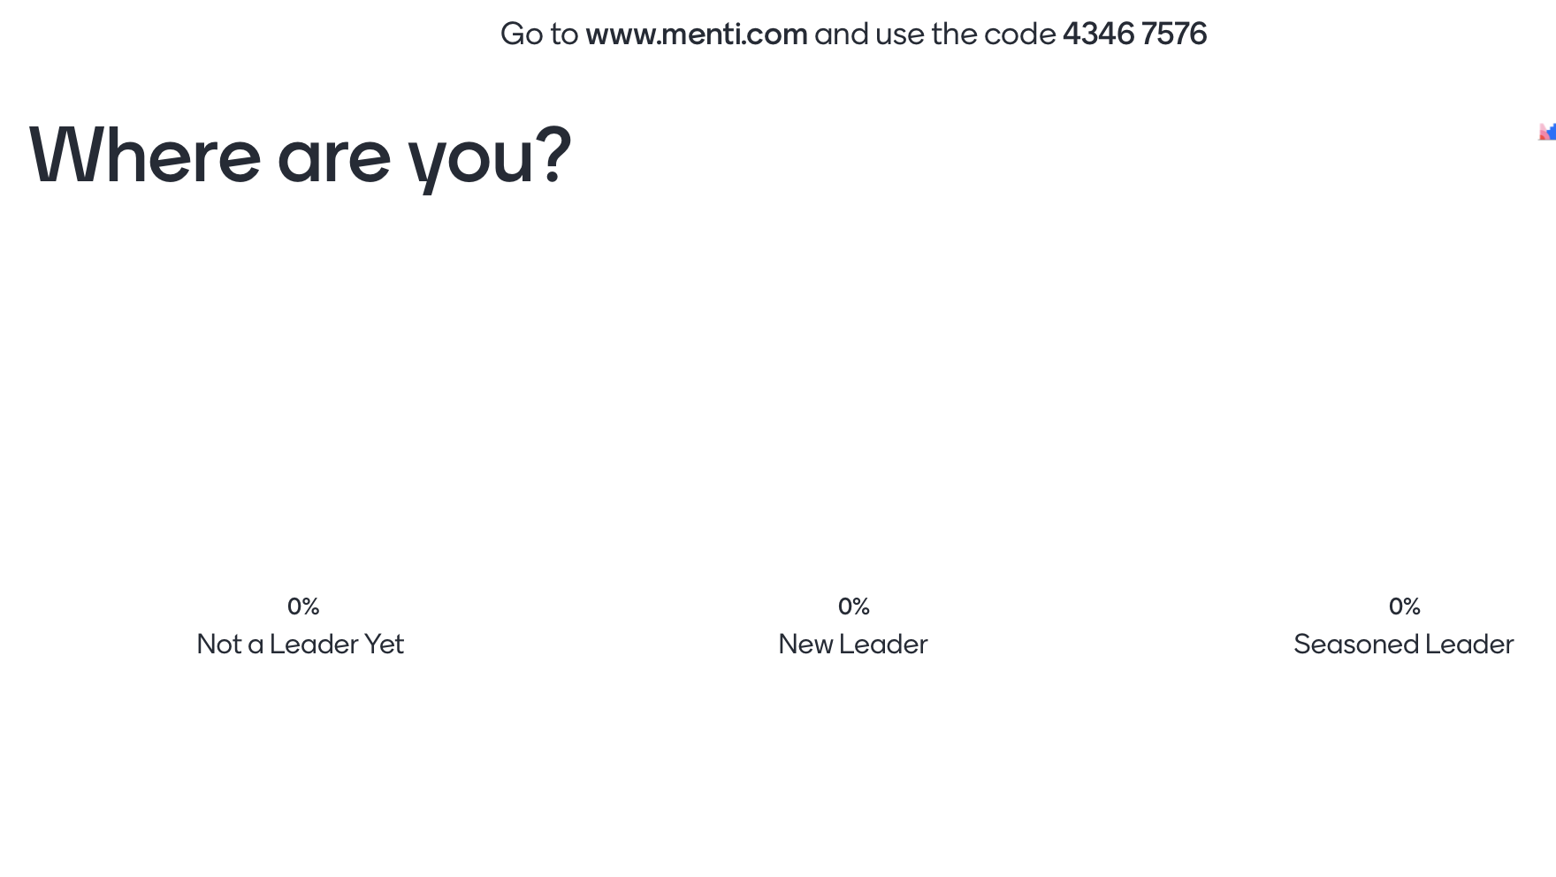

Slide 13
Purpose
People
Process

Slide 14
Definition of leader point:
A leader point is the moment of change that happens where you can choose to lead or choose to let it pass you by. Some will be obvious, and some will not be obvious
Use previous definition > quick point on this slide and then into identifying them

Slide 15
Some common signs of a leader point
That gut feeling where you “know” what should happen next but no one else sees it
When you are the most experienced or longest tenure
At the start of a project when direction is need
When a project is going off the rails
When things have reached a point of diminishing returns

Slide 16
Different stages of leadership provide different leader points

Slide 17
Early leader points
When team members come to you for advice
When in a group round table or planning where there is silence, people looking around
When a team needs to present an idea publicly

Slide 18
Build section 2 – Plan

Slide 19
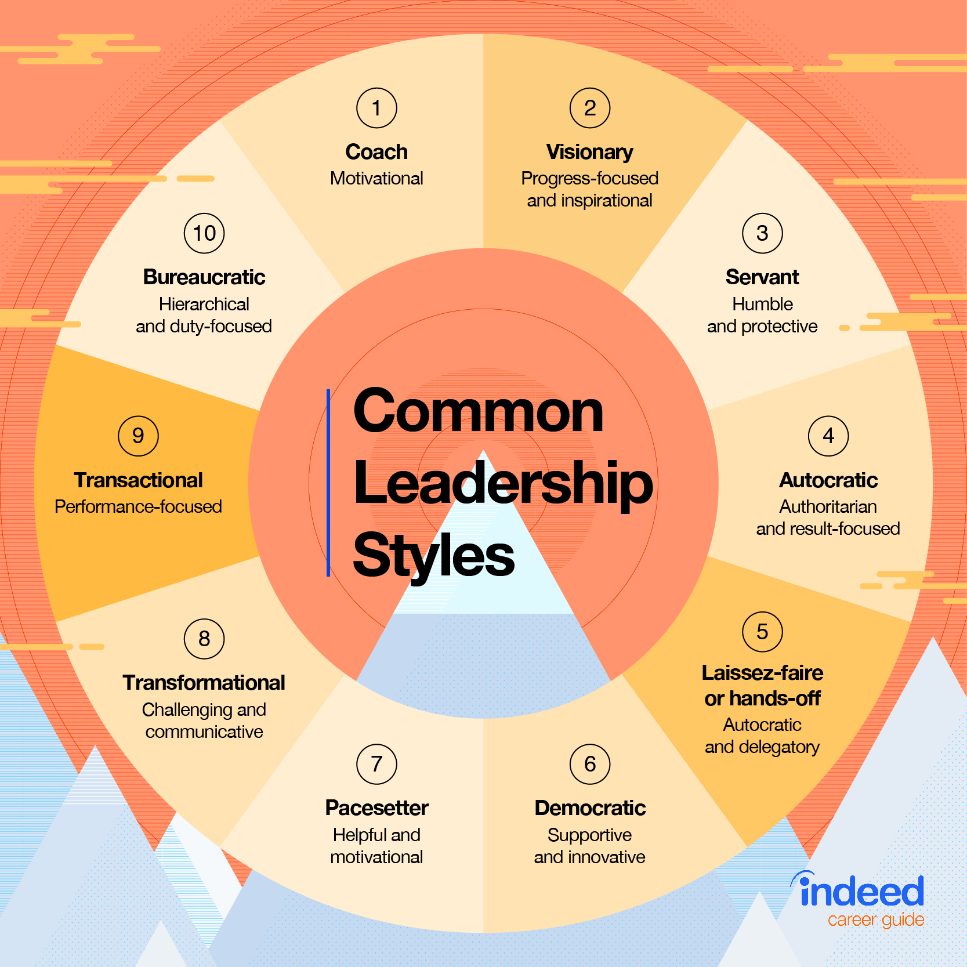
Types of leaders

Slide 20
Definition of leadership styles
https://www.indeed.com/career-advice/career-development/10-common-leadership-styles

Slide 21
What do I value more—goals or relationships?
Do I believe in structure or freedom of choice?
Would I rather make a decision on my own, or collectively?
Do I focus on short or long-term goals?
Does motivation come from empowerment or direction?
What does a healthy team dynamic look like to me?

Slide 22
What situations are you seeing?
How will you practice?

Slide 23
Build section 3 - Execute

Slide 24
Ways of Developing leadership
(Add slides for steps to develop)
https://www.wrike.com/blog/9-ways-develop-leadership-skills/

Slide 25
Practical tips
Be personal (relatable)
Build trust
Be confident
If you don’t trust yourself, why should others?

Slide 26
Put it all into practice
Identify > What are the leader points facing you?
Plan > What style or actions can you take?
Execute > When will you take action?

Slide 27
Conclude story

Slide 28
Take-aways

Slide 29
Book recommendations
Making a manager
Trillion Dollar coach
Leaders Eat Last

Slide 30
QA
Ways to contact me
Slide link on github

